Slide 1
PROVIDING DATA PRIVACY OF E- HEATHCARE DATA
BTech in Information Technology
PRESENTED BY
STUDENT NAME ROLL NO REGISTRATION
SUBHAJIT GHOSH 10000220058 201000100220058
JOTIRMAY SIKDAR 10000220060 201000100220007
RAJIB KUMAR MAJUMDER 10000219024 030957
SAPTARSHI MONDAL 10000219074 043001
Guided By:
SAYANTANI SAHA
Department of Information Technology.
Maulana Abul Kalam Azad University Technology, West Bengal, India

Slide 2

Motivation
We chose this project because working in healthcare will allow us to reach our aspirations to help others, earning a wage in the meantime. We can help bring a new life to the earth or save another life from ending. Working in healthcare, directly or indirectly to another person, we will be changing lives and impacting families.
our project motivation our respected prof. Sayantani Saha. she helped us in every stage and motivate us that how we can make this project more efficient. She shared us the problem statements and influnce us for brainstorming on that . so, I want to say, thank so much ma'am for your help

Slide 3
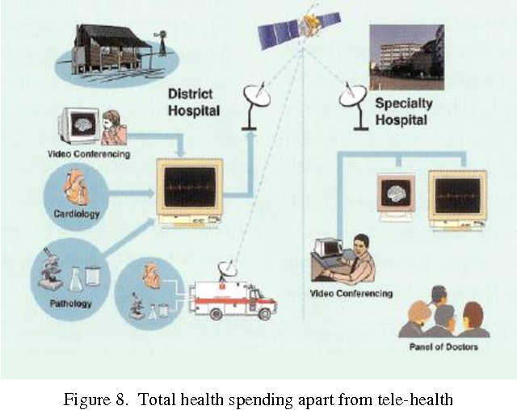
Literature Review
Digital health has the potential to prevent disease and lower healthcare costs, while helping patients monitor and manage chronic conditions. It can also tailor medicine for individual patients . Healthcare providers also can benefit from advances in digital health. Digital tools give healthcare providers an extensive view of patient health by significantly increasing access to health data and giving patients greater control over their health. The result is increased efficiency and improved medical outcomes.

Slide 4
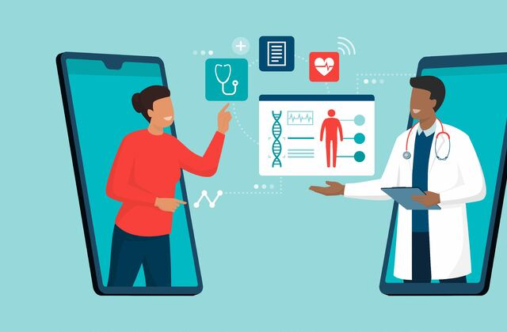
PROPOSED METHOD:
To collect most of the information about hospitalityand medical services.
• Patients are easily allocated to the doctors.
• Doctors search and pharmacy search is possible.

Slide 5
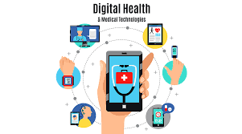
IN FUTURE
In future we will be using blockchain technical skills for data privacy.As a example we say that if a paitent admit in a hospital for his dieases .There dr .and register admin have some question for him .and its recorded by authority . And its stotre a data base.and second one is the same paitent is admit another hospital for another disease .here the previous hospital does not share the information of the paitent with the second hospital.Here is information blockage and data corrupt.only the dr. ,admin and the paitent accees the data.the pharmachist will not access the data .he just access the prescription.only the paitent have the main acees to share the data with the another hospital.
NOW:
we use html for web page
CSS for web colour and bootstrap for overall design

Slide 6
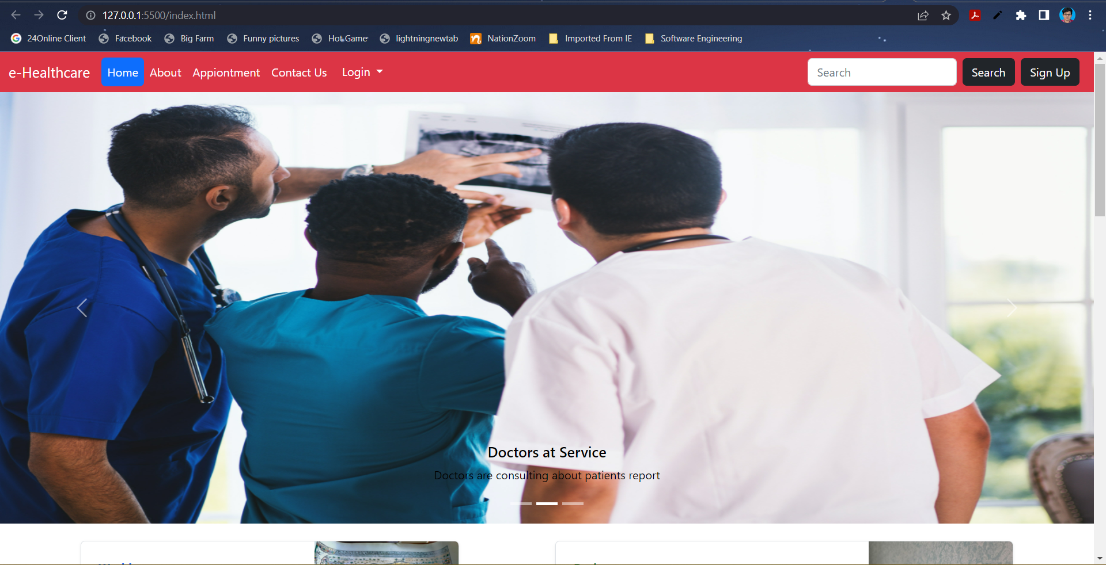

Slide 7
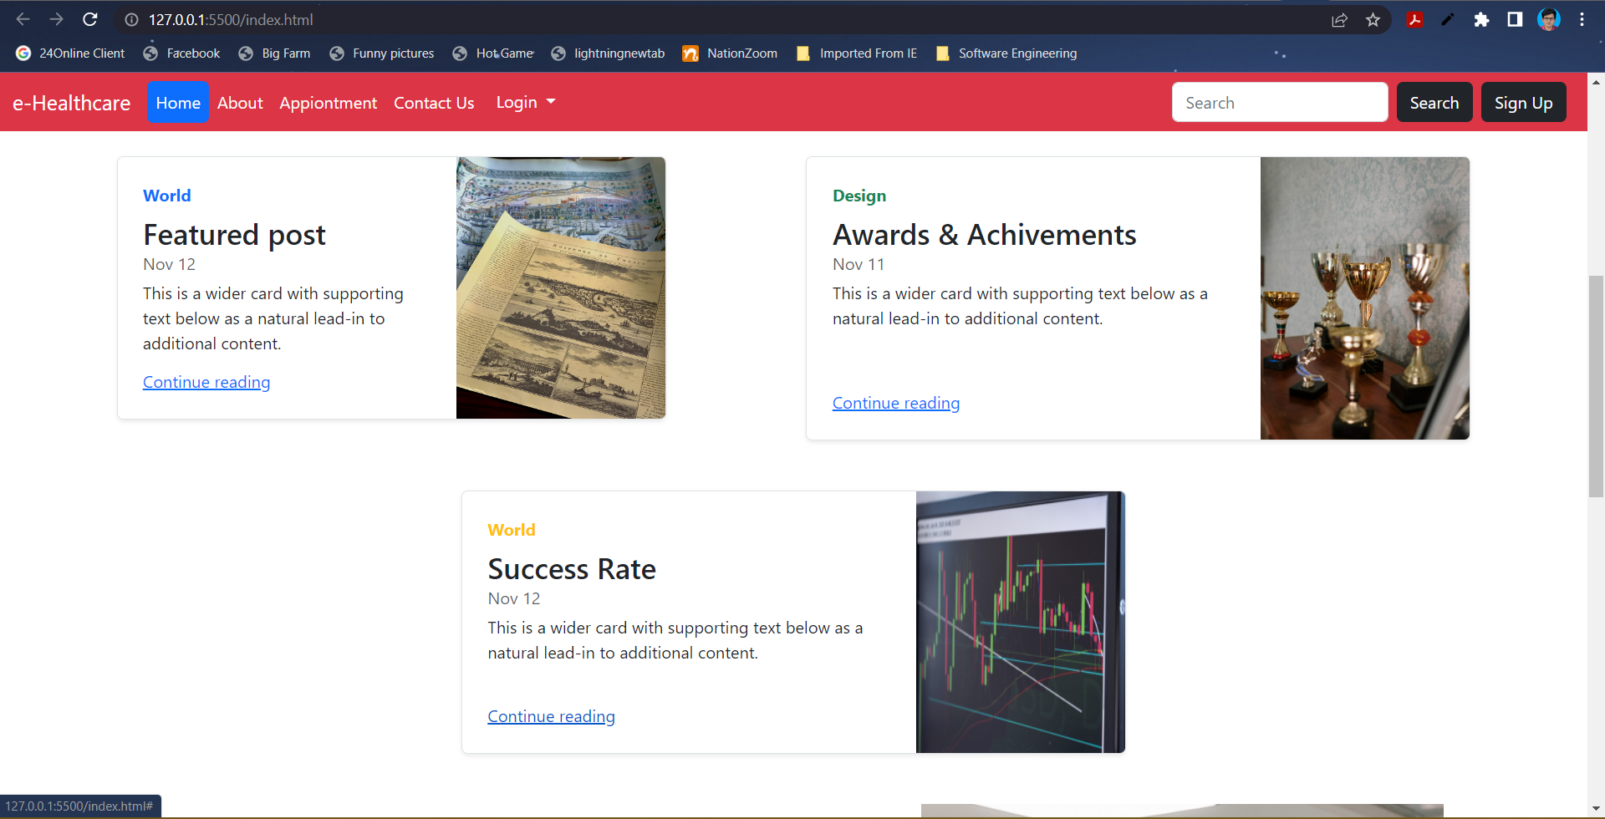

Slide 8
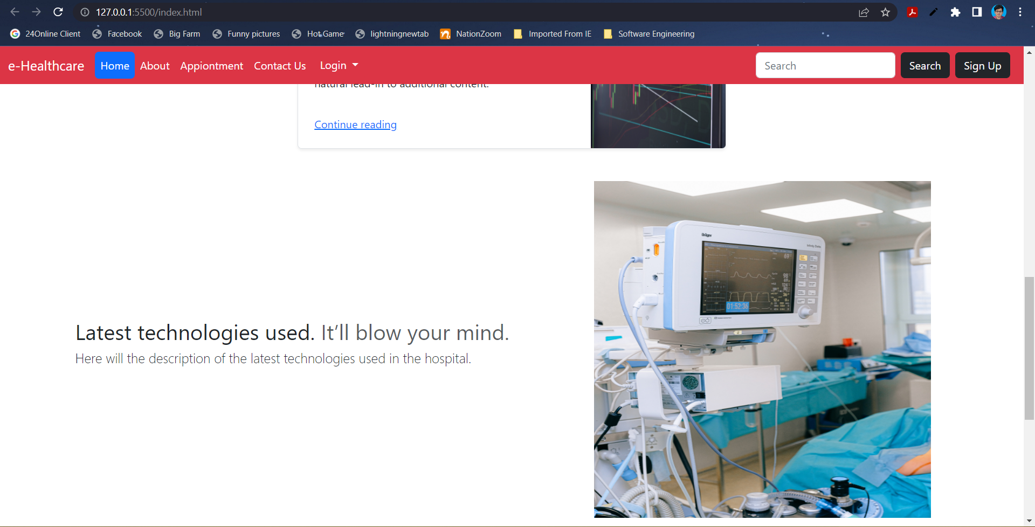

Slide 9
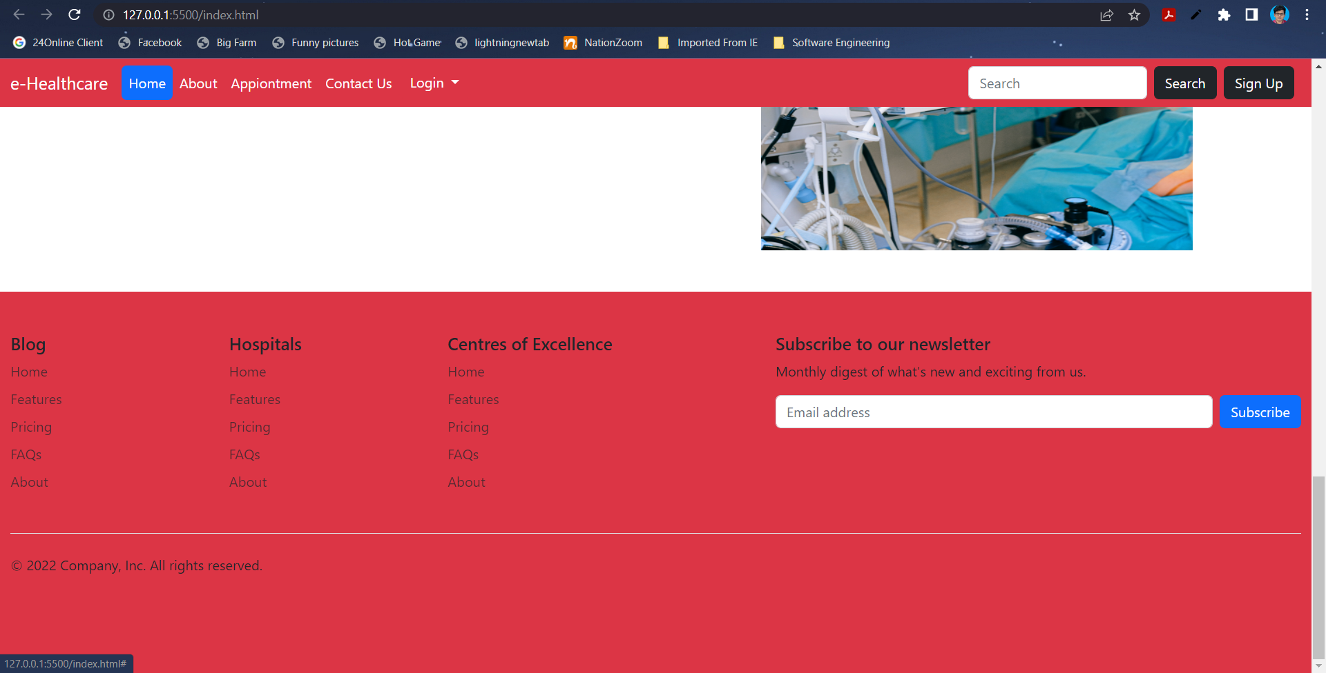

Slide 10
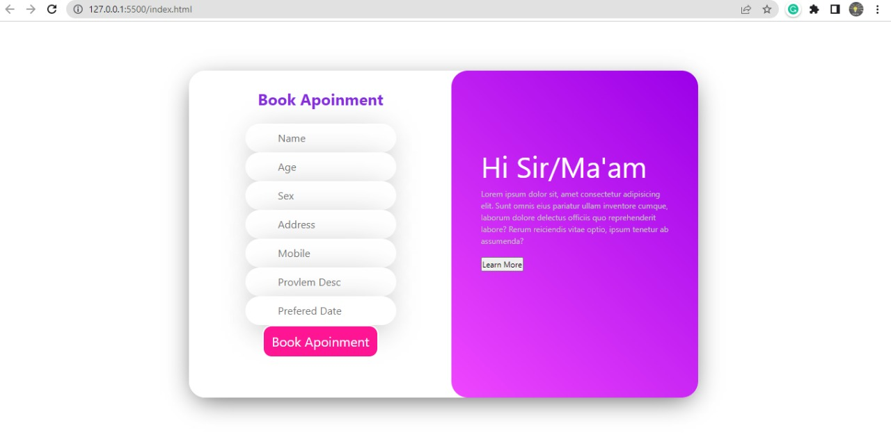
Experimental Results

Slide 11
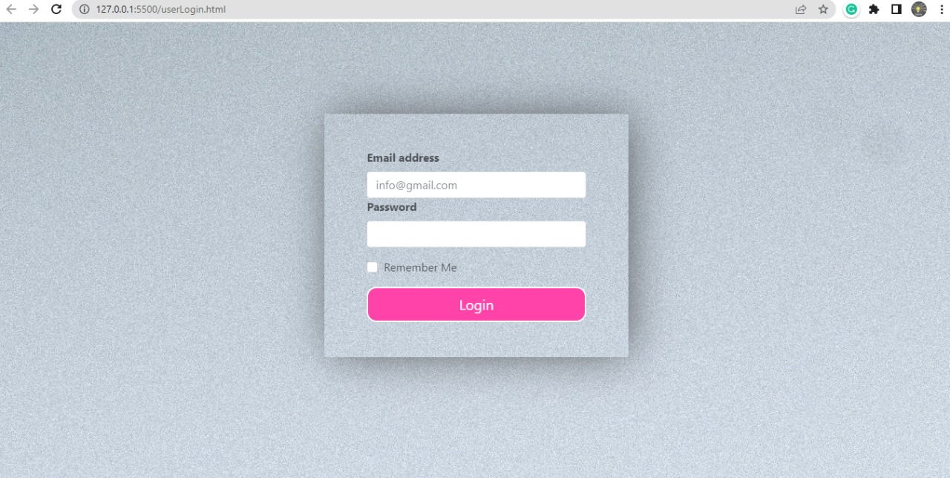

Slide 12
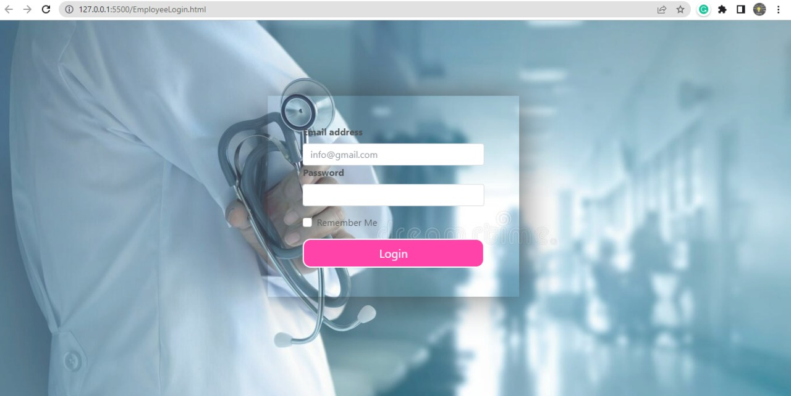

Slide 13
Conclusion
E-Health in the home is a potent, powerful and rich technology that offers significant benefits for many stakeholders.
We need to be sure, however, that when embracing this technology the elderly patient is not simply seen as another component in the "system“.
Individual patient needs and views regarding homecare and their health, safety, dignity, respect and fears must be listened to. With some limited exceptions, others cannot make assumptions in this personal and sensitive area.

Slide 14
Reference
Object oriented programming through java , P.Radha Krishna,universities press
• Thinking in java , Bruce Eckel , Person Edition.
• Data base management system systems,Raghu Ramakrishna,Johannes Gehrke , TMH,3rdedition,2003
• Web programming , Building internet applications , Chirs bates 2ndedition,wiley dreamtech

Slide 15
THANK YOU

